Slide 1
Getting Down To Business
DVCS & CI

Slide 2
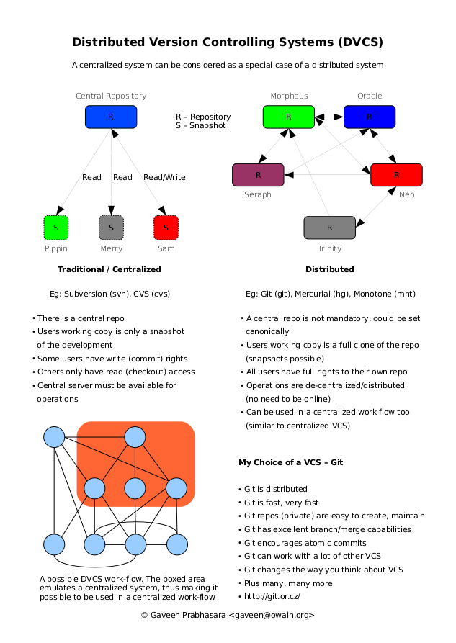
DVCS

Slide 3
Intro to DVCS with Hg
TortoiseHg - http://tortoisehg.bitbucket.org/
Learning - http://hginit.com/

Slide 4
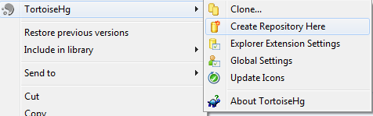
Init
hg init
hgtk – right click, initialize repo

Slide 5

Add/Remove
hg add, hg remove, hg addr
hgtk - right click, Hg Commit or Hg Workbench
add file
commit
modify file
commit
delete file
commit

Slide 6
Hg Workbench
AIO FTW – dedicated monitor
Repositories
History (vs hg log)
Diff
WIP
Status (vs hg status)
Diff (vs hg diff)
Unified
Changed
External
Commit w/ Message

Slide 7
More commands
Revert
Update
Shelve/Unshelve

Slide 8
Pushing
Create another repo
hg init
hg serve (web server, configurable)
Set upstream
filesystem, http/s, etc
Push changes
Review in browser

Slide 9
Cloning
hg clone (central repo)
review log!

Slide 10
Pushing
Change recipe
Push
Pull

Slide 11
Merging
Initial repo: Change recipe
Clone repo: Change recipe
Initial: push
Clone
Try Push
abort: push creates new remote heads on branch 'default'!
Check incoming
Pull
Post Pull – Nothing
Show log
Push
Initial
Pull w/ update

Slide 12
Rebasing
Initial repo: Add dessert.txt
Clone repo: Change recipe
Initial: push
Clone
Check incoming
Pull w/ rebase
Show log
Push
Initial
Pull w/ update
Show log

Slide 13
Productivity with DVCS

Slide 14
List Frustrations

Slide 15
Resources
http://geekswithblogs.net/wesm/archive/2010/04/28/how-i-do-vcs.aspx
http://geekswithblogs.net/wesm/archive/2011/02/06/things-ive-noticed-with-dvcs.aspx

Slide 16
Problem: Offline Access
hg clone https://wes_mcclure@bitbucket.org/lincolndev/lincolndev.net
Unplug internets
Open Hg Workbench!
History
Go back in time
Search
Commits

Slide 17
Problem: Merge Conflicts
Solution: Increase Frequency of Commits
Smaller commits
Easier to visualize conflicts

Slide 18
Problem: Large Incoherent Commits
Solution: Increase Frequency of Commits
Isolate intent
Add confidence

Slide 19
Problem: Infrequent Integration
Requiring integration to commit decreases frequency of commits and integration
Solution: Separate commit from integration
Increases frequency of commits
Easier to integrate

Slide 20
Problem: Unwanted Code
Solution: AIO tool
Easy to review commits

Slide 21
Problem: Commit without Message
Solution: AIO tool
Easy to add message
Solution: Increase frequency of commits
Smaller messages
Easier to describe

Slide 22
Problem: Visualizing Integration
Solution: AIO tool
Easier to
View log
See other contributions
Integrate
Stay focused

Slide 23
Problem: Exploratory coding
Solution: Throw away commits
Frequent commits isolates our work
Revert the whole commit!
Why waste time deciphering what you do/don’t need
Solution: Stash/Shelve

Slide 24
Problem: Exploding tasks
Solution: Local broken commits
Partial commits
Break tasks down
Push when ready

Slide 25
Problem: Branching
Sucked historically
Solution: Local branching
Anonymous branches
Named branches
Visualizing
Merging

Slide 26
Productivity & Git
Unlimited stashes
anonymous local branches
Use for config changes between environments
Unlimited rollback
git reset --soft HEAD~1
Rollup commits
Fix mistakes

Slide 27
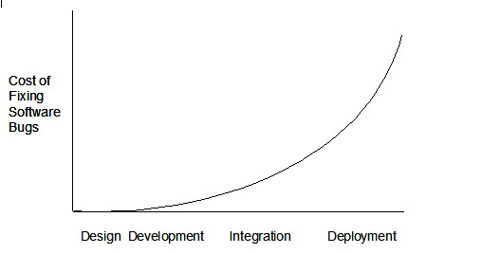
Continuous Integration

Slide 28
Automated Feedback
Failures
Build Failures
Missing Artifacts
Broken Tests
Success
Team feedback
Agile metrics

Slide 29
CCNet Resources
Free
ThoughtWorks
http://confluence.public.thoughtworks.org/display/CCNET/Welcome+to+CruiseControl.NET
GUI config
http://ccnetconfig.codeplex.com/
Not maintained

Slide 30
Steps
Run service
Connect via site
Configure project
Push changes
Review output

